Slide 1

Welcome to Sabbath School
Illustration by Jo Card. Copyright © 2024 General Conference Corporation® of Seventh-day Adventists.

Slide 2

EARLY ARRIVALS
EARLY
ARRIVALS

Slide 3

Books of the Bible
EARLY ARRIVALS
EARLY
ARRIVALS

Slide 4
Welcome to Sabbath School
Illustration by Jo Card. Copyright © 2024 General Conference Corporation® of Seventh-day Adventists.

Slide 5

Be Kind
OPENING ACTIVITIES
What you choose to do today
Can impact on others,
Maybe even hurt your sisters
And your brothers.
So think carefully about
What you say and what you do.
Choose what’s good.
Think of others ev’ry day.
(Continued on next slide)

Slide 6
Be Kind
OPENING ACTIVITIES
Choose what’s good.
Choose what’s right.
Think of the good things you can do And always do what’s right
Because you can make a difference,
You can let your light shine.
Ask Jesus to help you to be kind.
(Continued on next slide)

Slide 7
Be Kind
OPENING ACTIVITIES
What you choose to do today
Can impact on others,
Maybe even hurt your sisters
And your brothers.
So think carefully about
What you say and what you do.
Choose what’s good.
Think of others ev’ry day.
(Continued on next slide)

Slide 8
Be Kind
OPENING ACTIVITIES
Choose what’s good.
Choose what’s right.
Think of the good things you can do And always do what’s right
Because you can make a difference,
You can let your light shine.
Ask Jesus to help you to be kind.
(Continued on next slide)

Slide 9
Be Kind
OPENING ACTIVITIES
Choose what’s good.
Choose what’s right.
Think of the good things you can do And always do what’s right
Because you can make a difference,
You can let your light shine.
Ask Jesus to help you to be kind.
Ask Jesus to help you to be kind.
"Be Kind" by Kimberly Houliston, copyright © 2022 Abide Family Ministries. Used by permission.

Slide 10
God Is So Wonderful
OPENING ACTIVITIES
Our God is so wonderful,
Our God is so great.
We want to worship You,
And praise Your mighty name.
Our God is so powerful,
We lift Your name on high.
We worship You,
And love to give You praise.
(Repeat above)
"God Is So Wonderful" by Kimberly Houliston, copyright © 2011 Abide Family Ministries. Used by permission.

Slide 11
Sabbath Song
OPENING ACTIVITIES
He made us, He saved us,
He’s coming back to take us home.
(Repeat two times)
Jesus, You are welcome in this place.
Father, You are welcome in this space.
Holy Spirit, fill our hearts with grace.
In this palace of time and space.
(Repeat above)
In this palace of time and space.
"Sabbath Song" by Alexandria and Leighton Heise, copyright © 2020, Alexandria and Leighton Heise. Used by permission.

Slide 12

PRAYER
PRAYER

Slide 13

OFFERING

Slide 14

Thank You, Jesus
OPENING ACTIVITIES
Thank you, Jesus
For providing all my needs.
I want to give a little back
Of what you’ve given me.
Please bless our
Sabbath School offering.
May it bring You glory
And help others in need.
(Repeat above)
May it bring You glory
And help others in need.
"Thank You, Jesus" by Rosie Smith, copyright © 2024 General Conference Corporation® of Seventh-day Adventists.

Slide 15
MISSION
FAST FACT &
OFFERING
CHART

Slide 16
Visitor Song
OPENING ACTIVITIES
We have a new friend
With us today.
We have a new friend.
Let’s smile and wave.
We welcome you to Sabbath School.
We’re glad you came.
We welcome you,
And hope to see you again. (x2)
“Visitor Song” by Rosie Smith. Copyright © 2025 General Conference Corporation® of Seventh-day Adventists.

Slide 17
Happy Birthday
OPENING ACTIVITIES
Happy birthday, happy birthday,
Happy birthday to you.
Jesus loves you dear ___________.
Happy birthday to you.
(Repeat above)
“Happy Birthday” by Janet Sage, copyright © 2001 North American Division Corporation of Seventh-day Adventists. From Little Voices Praise Him, #39. Used by permission.

Slide 18

FOCUS
ACTIVITIES

Slide 19
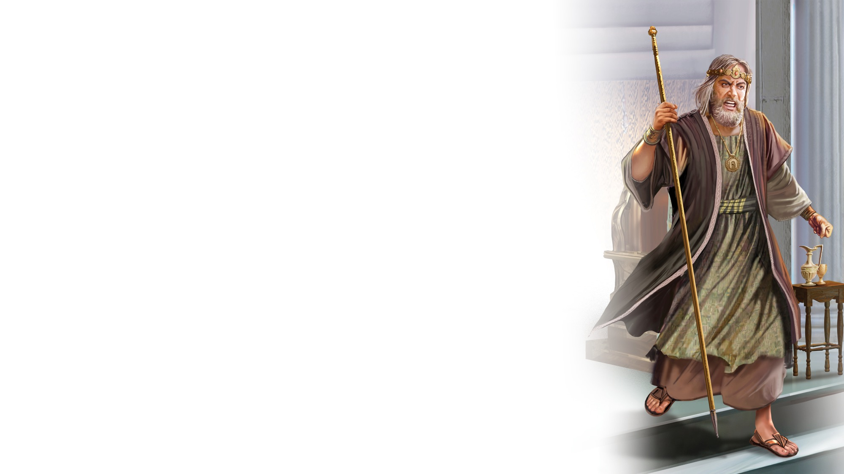
BIG IDEA
God can guide
my life.

Slide 20

BIBLE
STORY

Slide 21
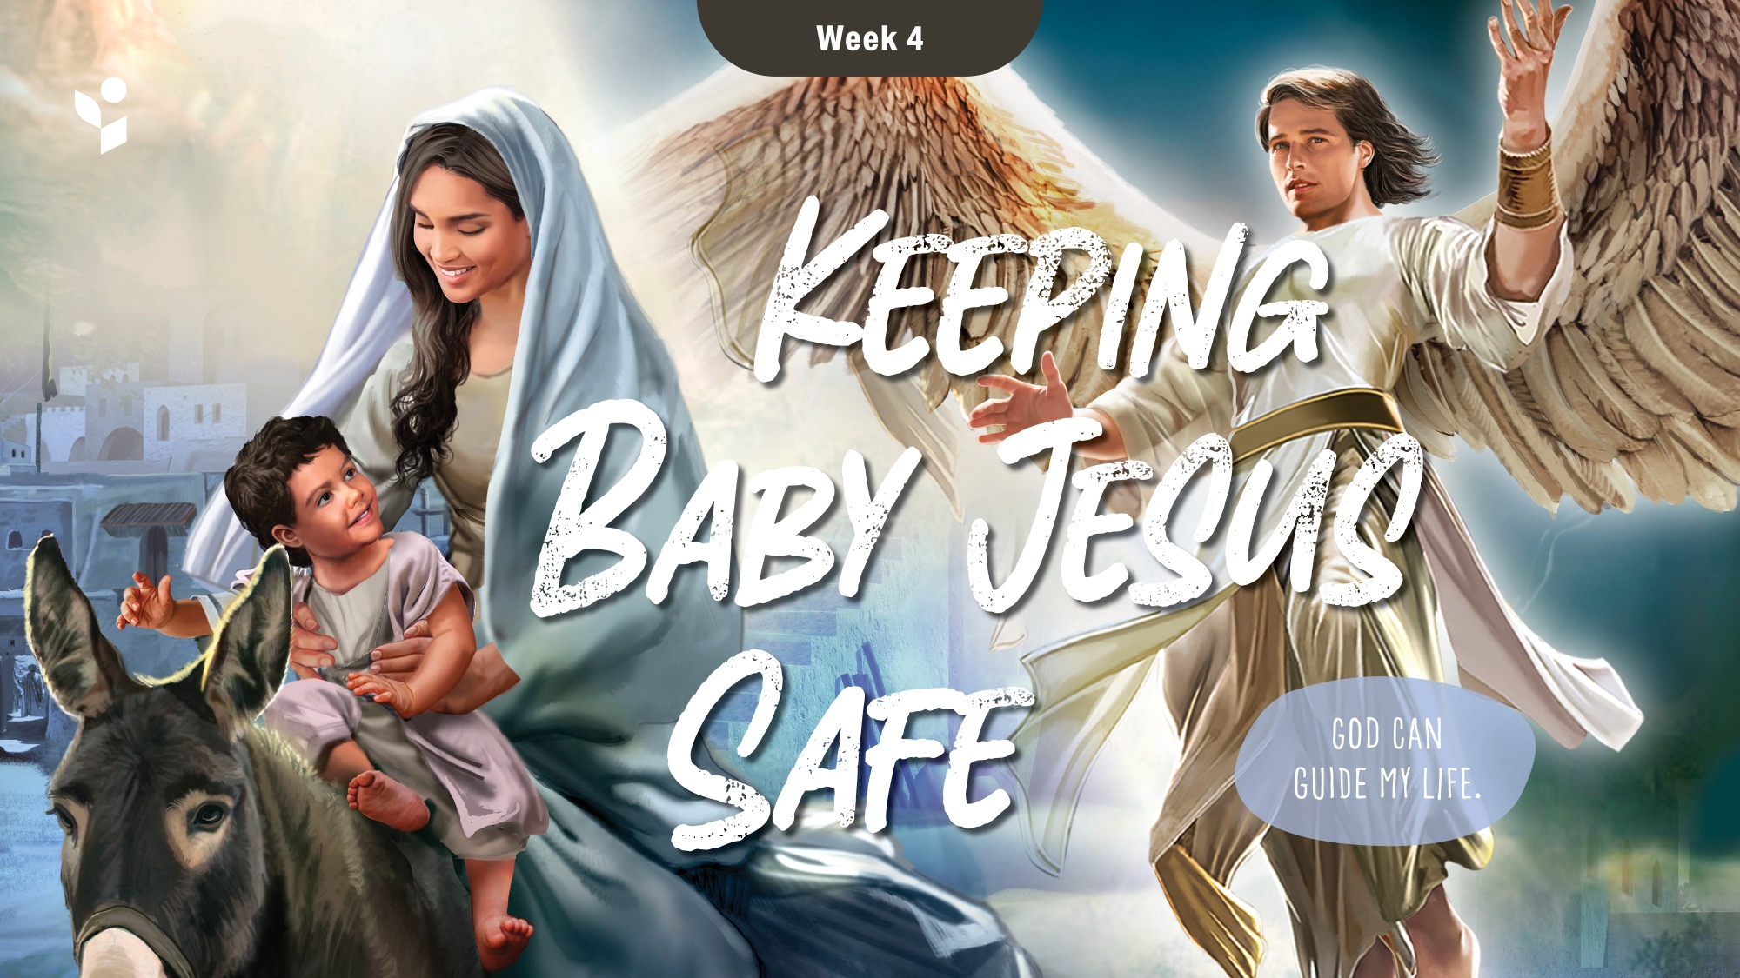

Slide 22
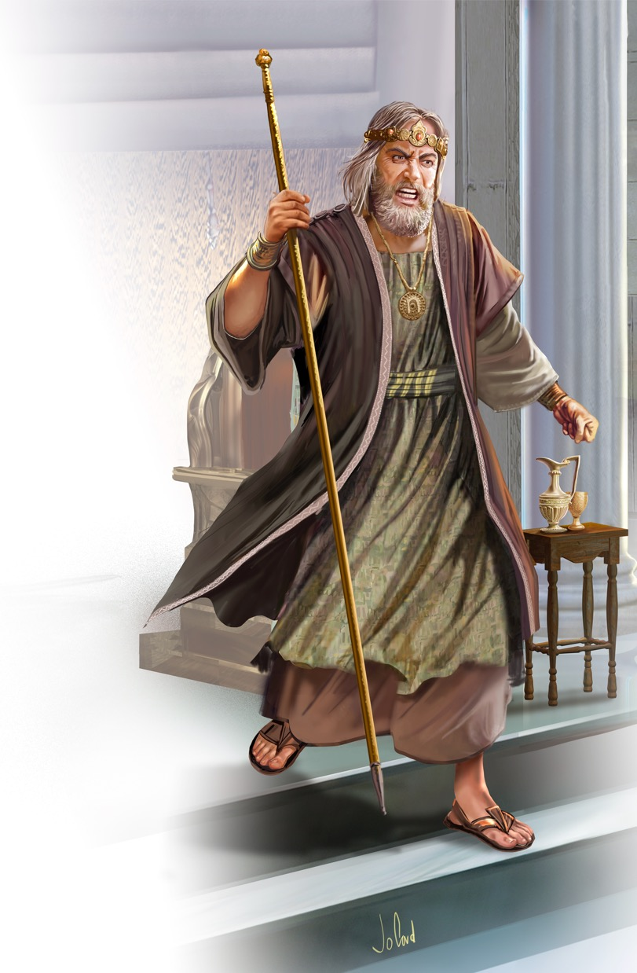
Illustration by Jo Card. Copyright © 2024 General Conference Corporation® of Seventh-day Adventists.

Slide 23
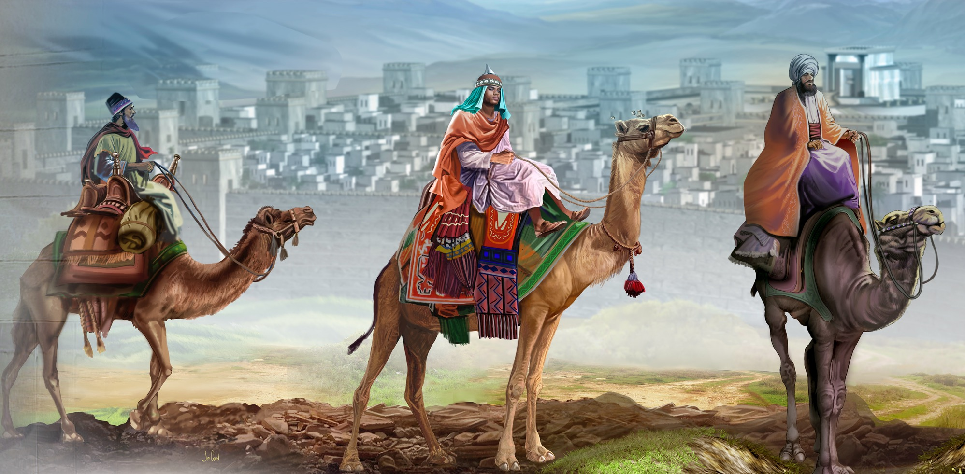
Illustration by Jo Card. Copyright © 2024 General Conference Corporation® of Seventh-day Adventists.

Slide 24
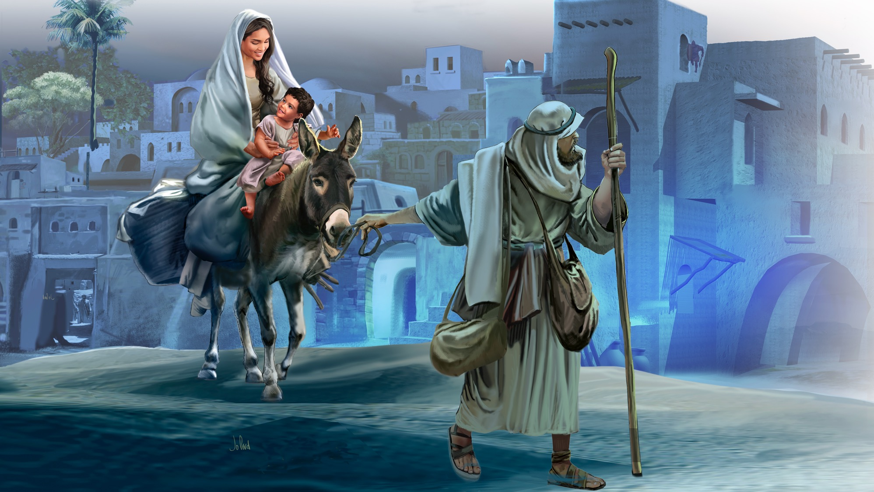
Illustration by Jo Card. Copyright © 2024 General Conference Corporation® of Seventh-day Adventists.

Slide 25
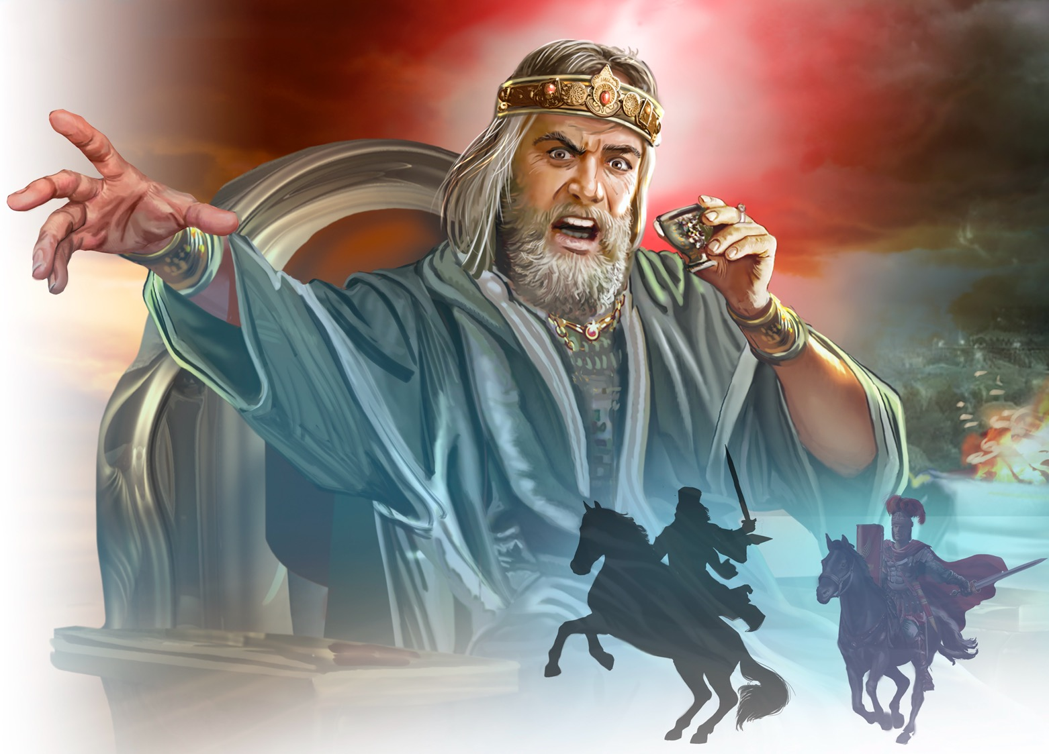
Illustration by Jo Card. Copyright © 2024 General Conference Corporation® of Seventh-day Adventists.

Slide 26
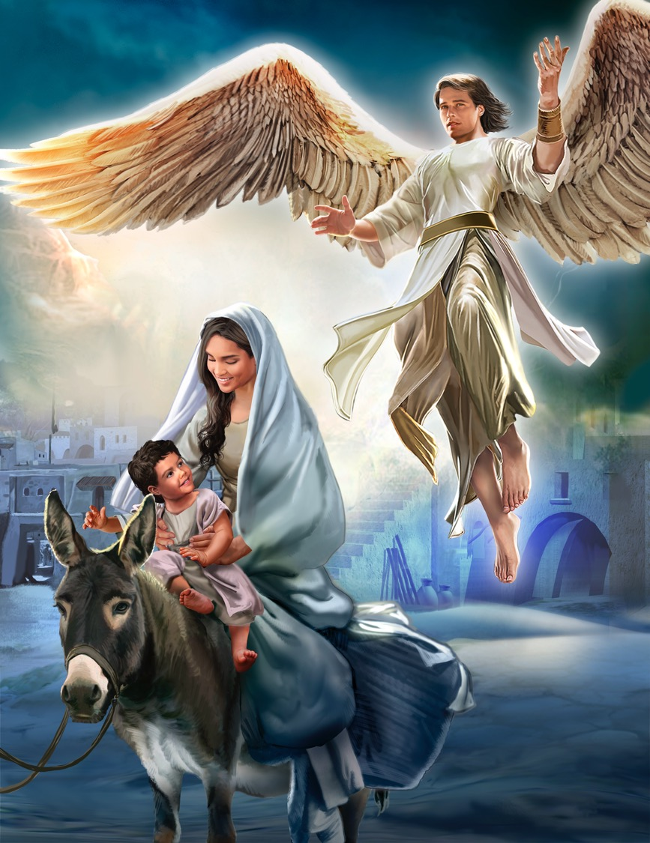
Illustration by Jo Card. Copyright © 2024 General Conference Corporation® of Seventh-day Adventists.

Slide 27
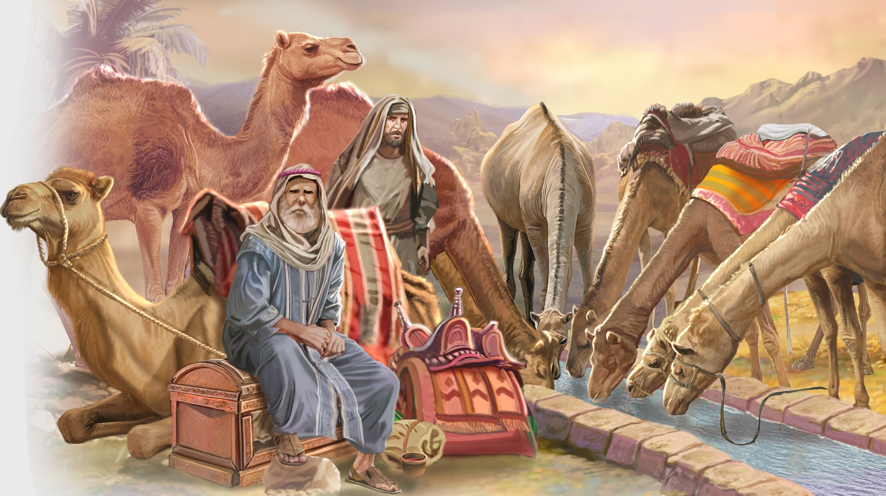
Illustration by Jo Card. Copyright © 2024 General Conference Corporation® of Seventh-day Adventists.

Slide 28
UNPACK
THE STORY

Slide 29
BIG IDEA
God can guide
my life.

Slide 30
PRAYER
PRAYER

Slide 31

CHARACTER CARDS

Slide 32
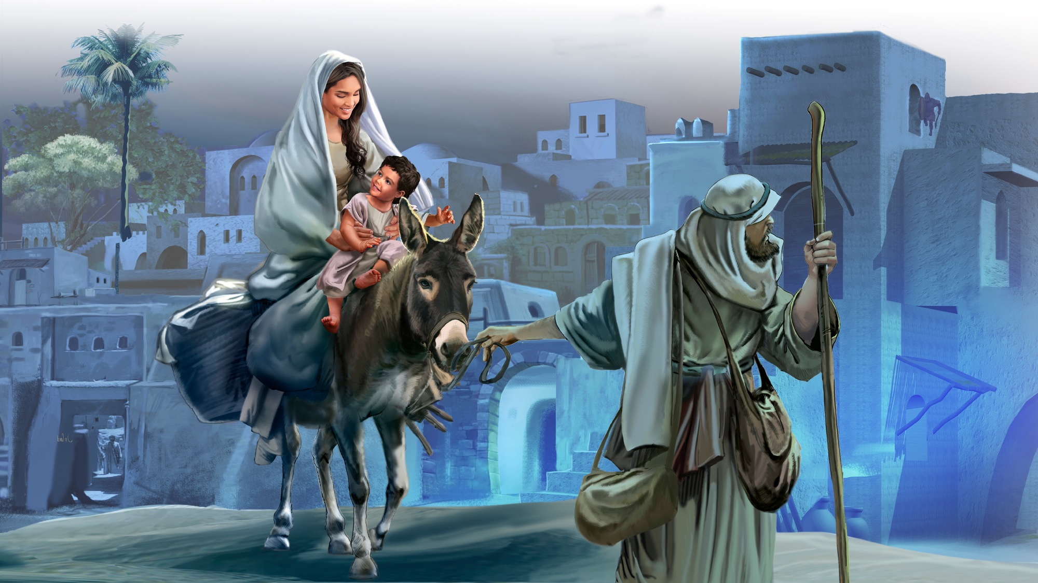
MEMORY VERSE
“I will instruct you and teach you in the way you should go; I will guide you with My eye.” Psalm 32:8

Slide 33
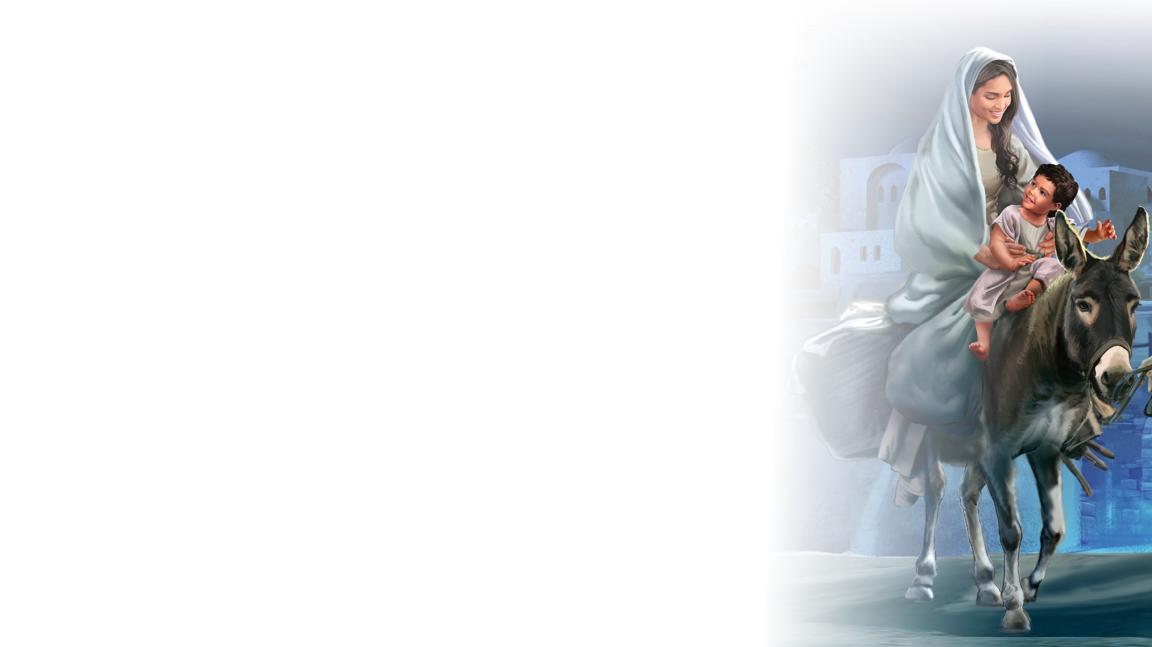
Psalm 32:8
SCRIPTURE SONG
I will instruct you
And teach you
In the way you
Should go.
I will guide you
With My eye.
Psalm 32 verse 8.
(Repeat above)
"Psalm 32:8" music by Rosie Smith, copyright © 2026 General Conference Corporation® of Seventh-day Adventists.

Slide 34
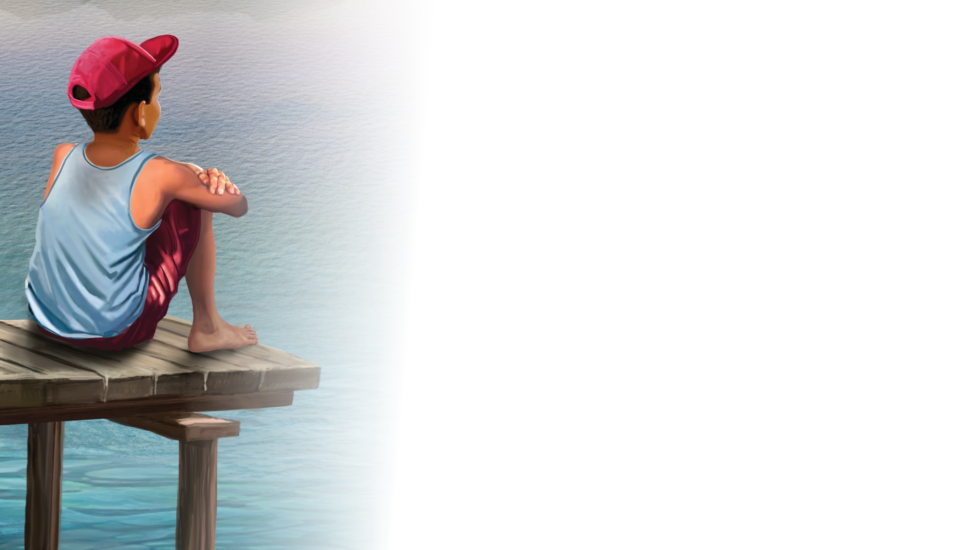
NATURE
LESSON

Slide 35

CRAFT

Slide 36

God Bless You
CLOSING SONG
What did you enjoy today?
What did you learn that’s new?
It’s time for us to say,
“Goodbye and see you soon.”
(Repeat above)
We’ll see you again,
So until then,
God bless you.
(Repeat above)
God bless … you!
"God Bless You" by Rosie Smith, copyright © 2025 General Corporation® of Seventh-day Adventists.

Slide 37
BIG IDEA
God can guide
my life.

Slide 38

MISSION
CHALLENGE

Slide 39

PRAYER
PRAYER

